Slide 1
Constructive Deep Neural Network for Breast Cancer Diagnosis
Usage of Recurrence Score prediction of the ODX assay in a newly proposed BC-CAD
Presented by:
Alyakaev Kamil
Ushakov Stanislav

Slide 2
Background
• ODX — oncotype DX assay. 21-gene test with Recurrence Score as output.
Recurrence Score
Low Risk:
RS <18
Intermediate Risk:
18 ≤ RS < 31
High Risk
RS ≥ 31

Slide 3
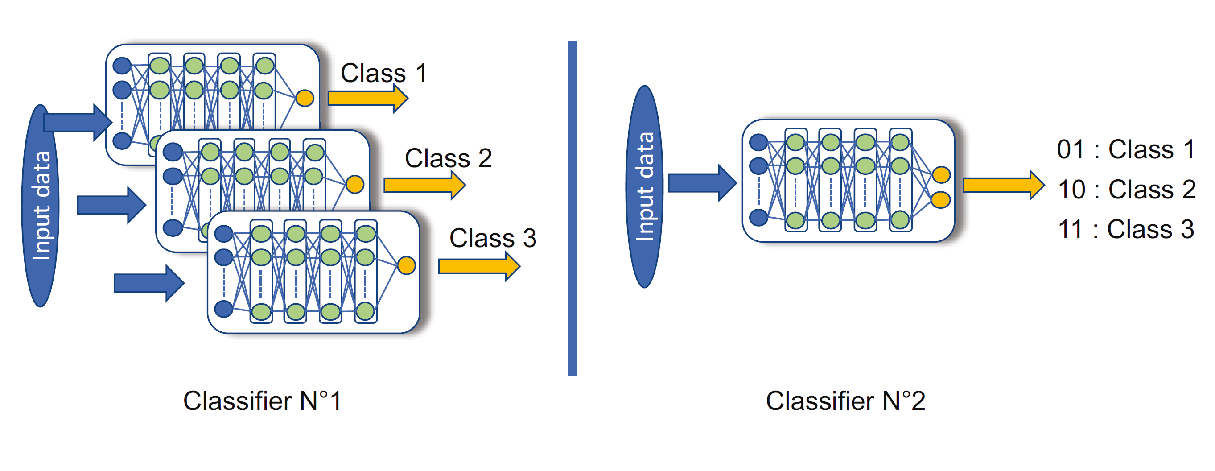
Used Classifiers

Slide 4
CNN types
Hybrid Algorithms
Constructive (growing) Algorithms:
Upgrade the net
Pruning Algorithms:
Downgrade the net

Slide 5
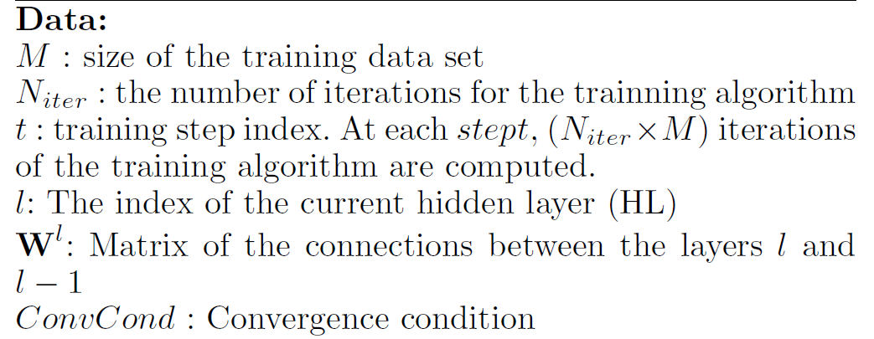
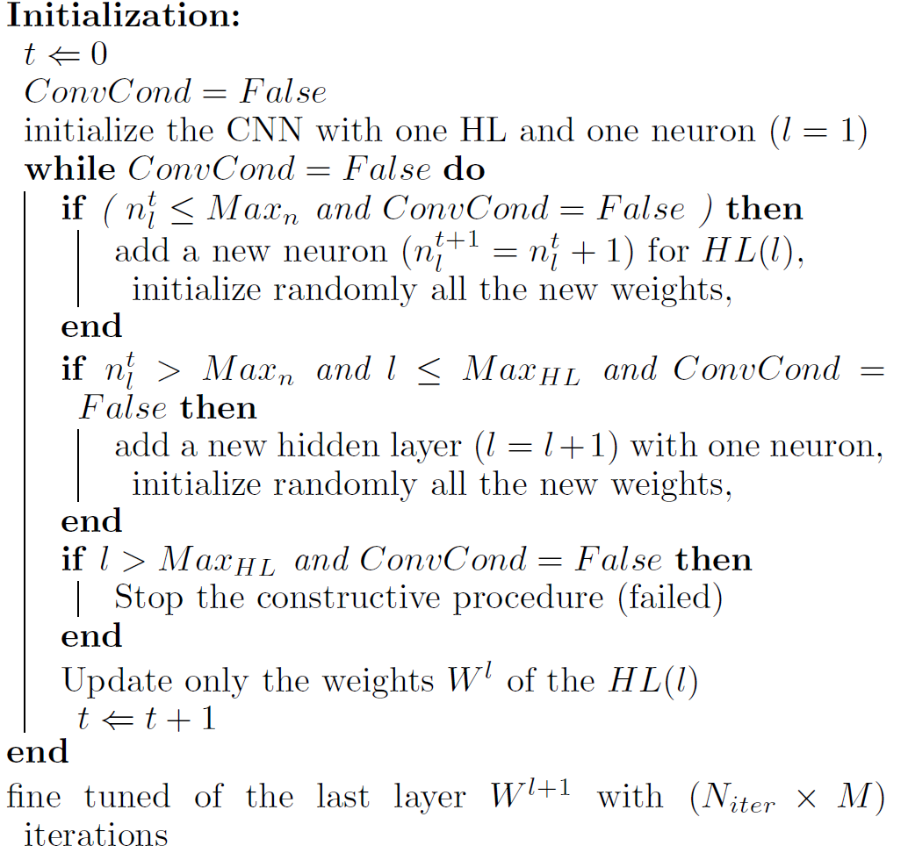
Constructive Deep Neural Network

Slide 6
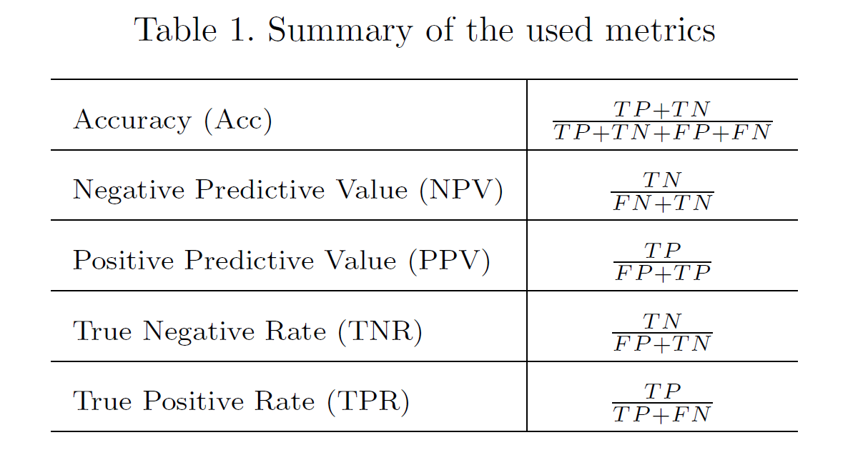
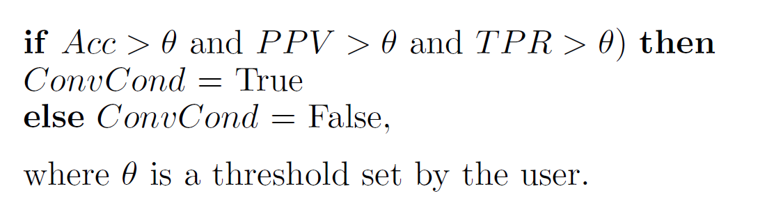
Convergence Condition

Slide 7
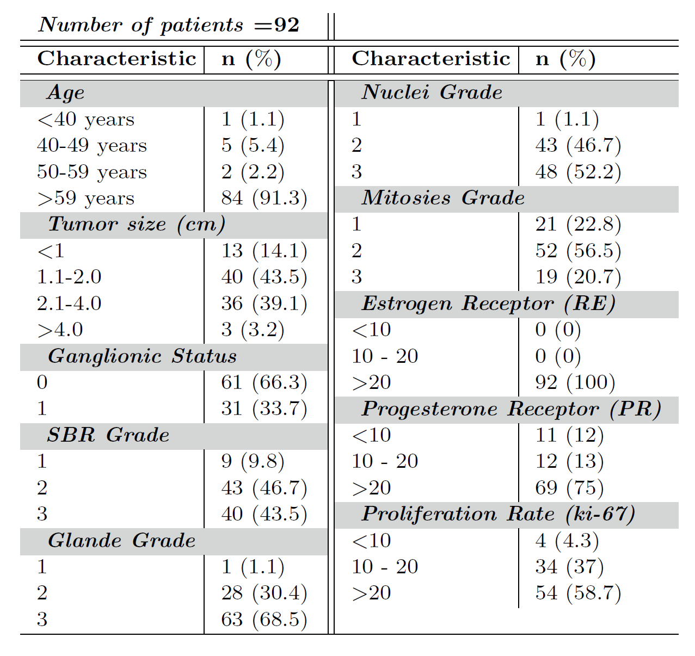
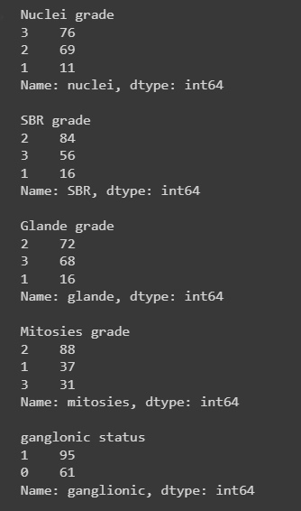
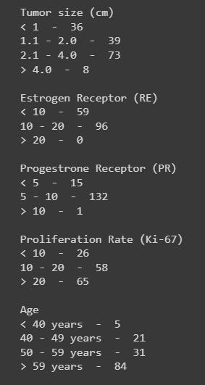
Data Description And how we found the dataset (sort of)
Patient and tumor characteristics in paper
Patient and tumor characteristics in our case

Slide 8
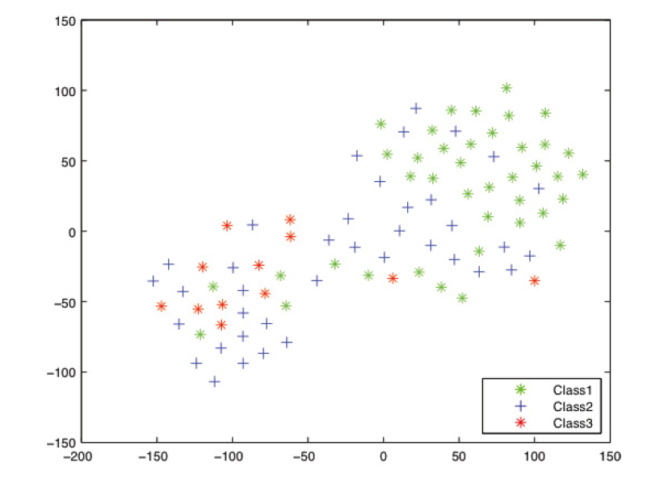
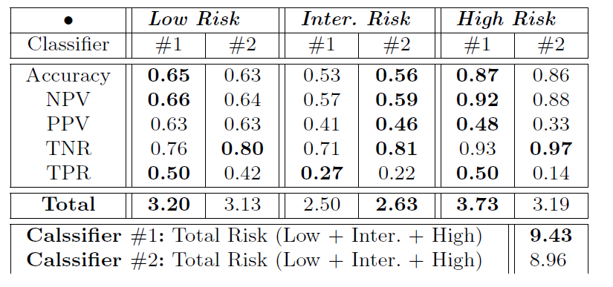
Authors’ Results

Slide 9
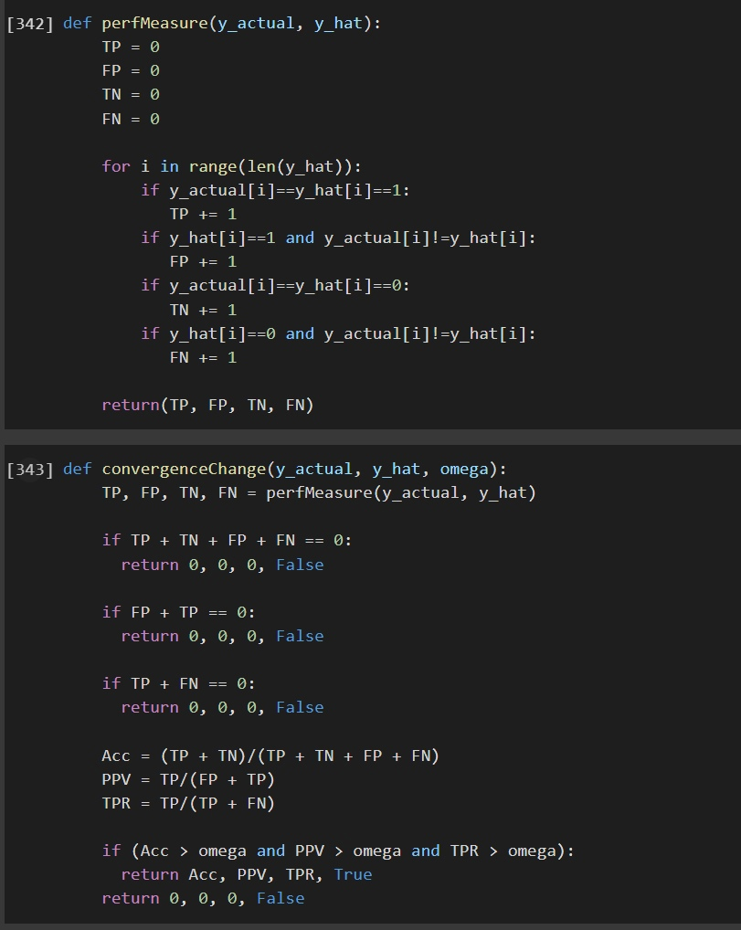
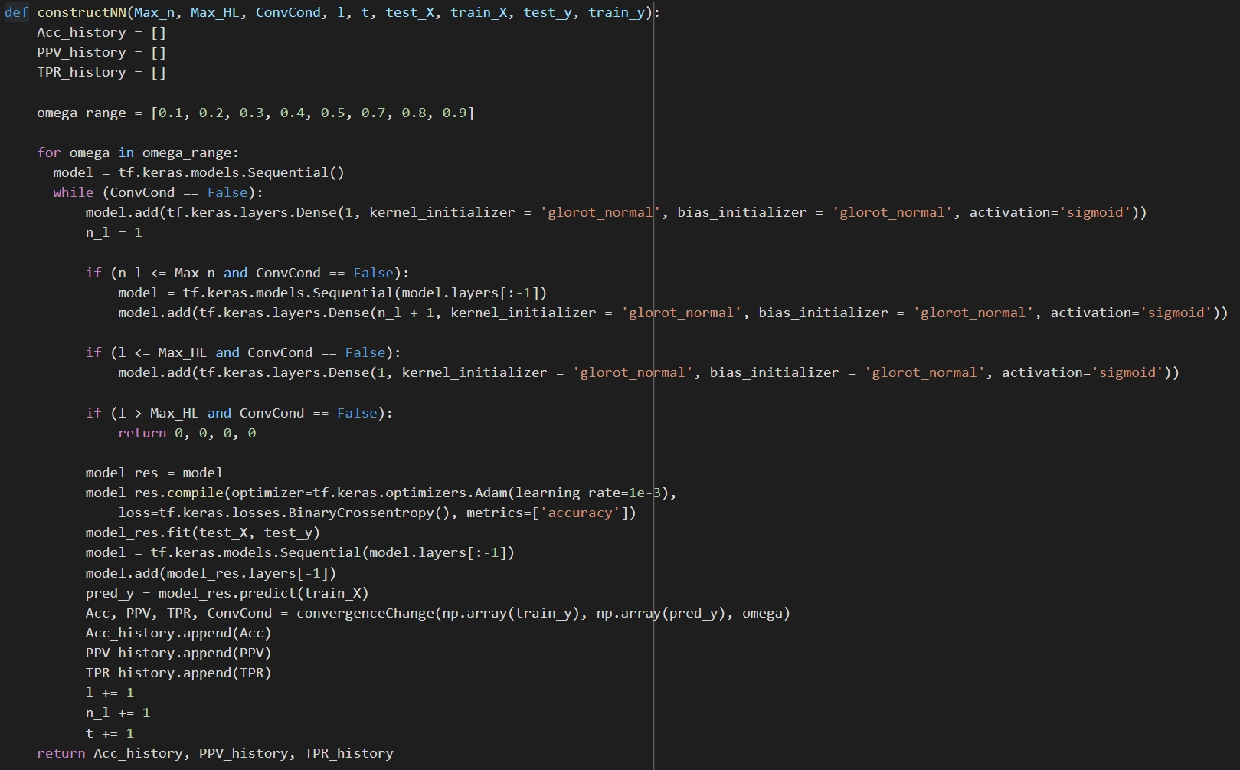
Our Results

Slide 10
Criticism
• Algorithm is not interpretable and has grammatic errors that made us question the logic of it.
• Original Dataset is not available.
• There is nothing said about the environment authors used to build the DNN in.
• Parameters used in the paper are not specified, neither the method that they used to find the parameters is.
• Authors introduce the concept of pruning and hybrid algorithms, but only ever use the constructive algorithm.
• Binary confusion matrix metrics are used to evaluate a multi-class model.

Slide 11


Thank you for your attention!
Our code &
presentation
Original dataset

